Slide 1

Week 4: Linear Unsupervised Learning
Part 2- Recommender Systems
Dr Maha Saadeh

Slide 2
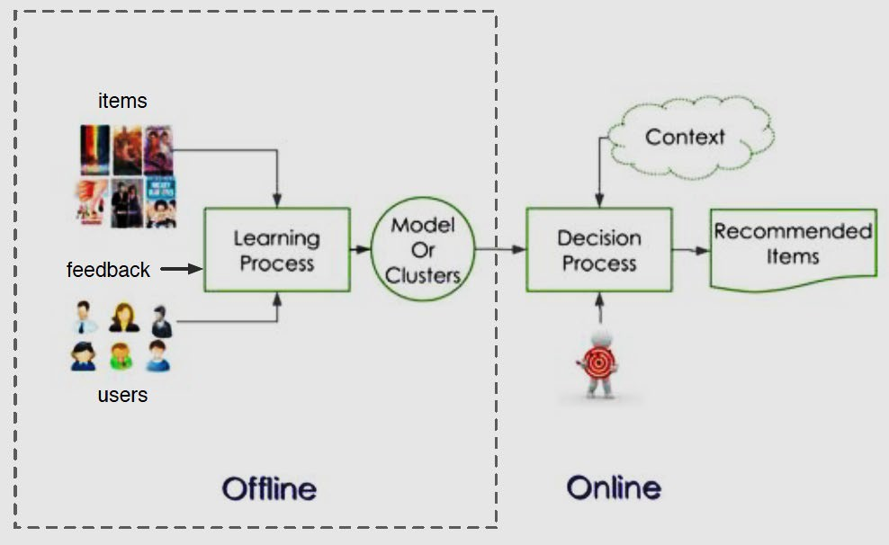
Recommender Systems
In this Section we discuss the fundamental linear Recommender System, a popular unsupervised learning framework commonly employed by businesses to help automatically recommend products and services to their customers.

Slide 3
Recommender Systems
Recommender systems are heavily used in e-commerce today, providing customers with personalized recommendations for products and services by using a consumer's previous purchasing and rating history, along with those of similar customers.

Slide 4
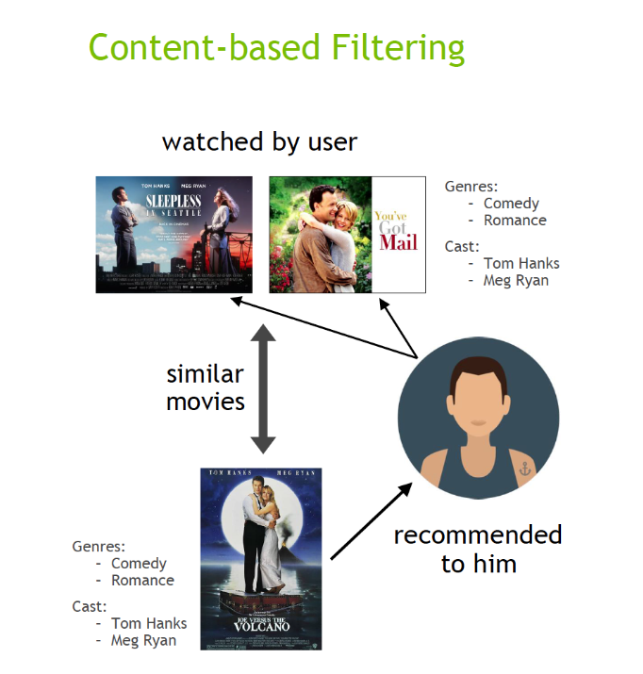
Two Types of Recommender Systems
Content Filtering
Creating explicit profiles for products, and profiles for users (or past behaviour)
Associate users with matching products.
Uses the attributes or features of an item (this is the content part) to recommend other items similar to the user’s preferences.
This approach is based on similarity of item and user features, given information about a user and items they have interacted with.

Slide 5
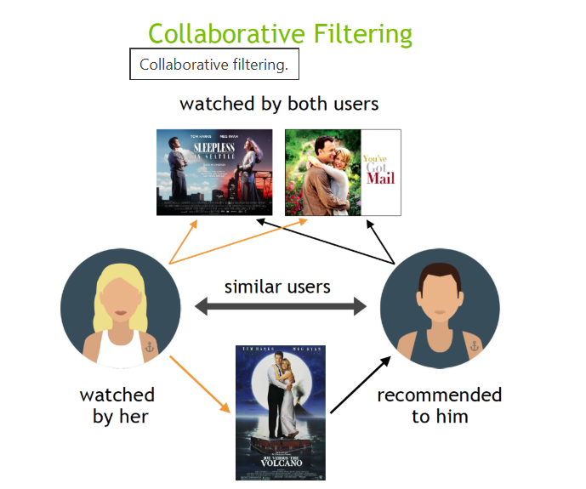
Two Types of Recommender Systems
Collaborative Filtering
Use past user behaviour and analyse relationships between users and interdependencies among products to identify new user-product associations.
Common insight:
Personal tastes are correlated
If Alice and Bob both like X, and Alice likes Y, then Bob is more likely to like Y

Slide 6
Collaborative Filtering
For instance, a movie provider like Netflix with millions of users and tens of thousands of movies, records users' reviews and ratings in a large matrix such as the one illustrated below in the Figure.
A movie rating matrix is very sparsely populated, with each user having rated only a very small number of films.

Slide 7
Rating Matrix
In order to provide recommendations to users, we aim to intelligently guess the values of every missing entry in the ratings matrix (we complete the matrix).

Slide 8
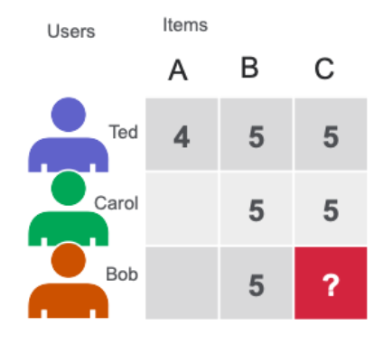
How collaborative filtering handles missing values
Matrix Factorization calculate the similarity in user’s ratings or interactions to provide recommendations. In the simple user item matrix below, Ted and Carol like movies B and C. Bob likes movie B. To recommend a movie to Bob, matrix factorization calculates that users who liked B also liked C, so C is a possible recommendation for Bob.

Slide 9
How collaborative filtering handles missing values
The problem MF is solving
You start with a sparse rating matrix:
Rows → users
Columns → items
Most entries → missing
Goal:
Predict the missing ratings as accurately as possible.

Slide 10
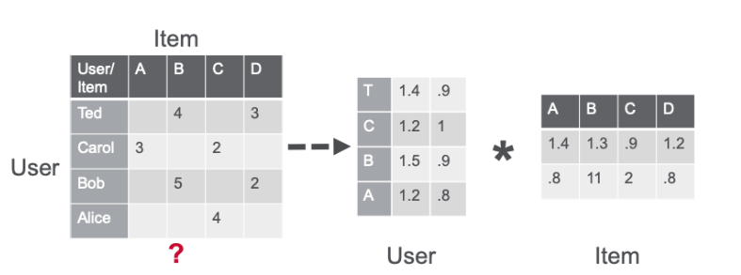
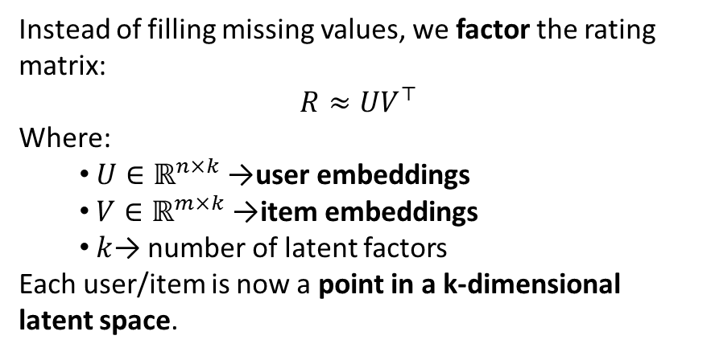
How collaborative filtering handles missing values
Instead of filling missing values, we factor the rating matrix:
$$R≈UV^{⊤}$$
Where:
$U∈ℝ^{n×k}$→ user embeddings
$V∈ℝ^{m×k}$→ item embeddings
$k$→ number of latent factors
Each user/item is now a point in a k-dimensional latent space.
Latent space is a low-dimensional, hidden space where each object is represented by a vector that captures its underlying characteristics.

Slide 11
Rating Matrix-Understanding Embedding Vectors
Score = user embedding⋅item embedding
A user embedding represents a user’s preferences
An item embedding represents an item’s characteristics

Slide 12
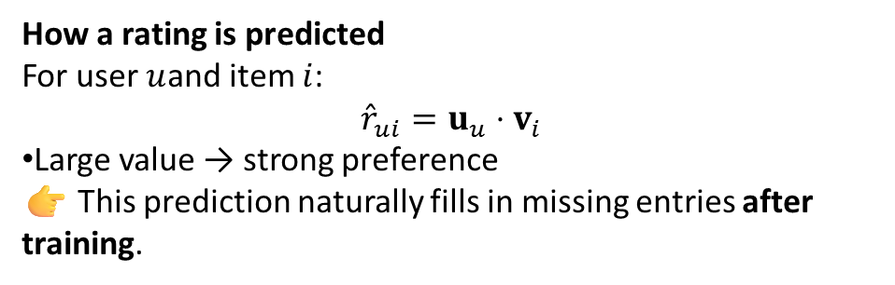
How collaborative filtering handles missing values
How a rating is predicted
For user $u$and item $i$:
$${\hat{r}}_{ui}=u_{u}⋅v_{i}$$
Large value → strong preference
👉 This prediction naturally fills in missing entries after training.
Note that missing entries are simply not in the training
Matrix factorization (MF) learns low-dimensional embeddings for users and items by fitting only the observed ratings, then uses dot products to predict the missing ones.

Slide 13
Python Example
MF to fill the missing values in the rating matrix

